Slide 1
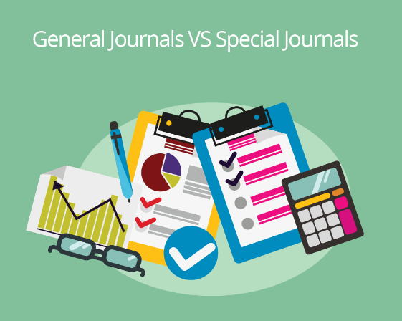
Sub Division of Journal
Subsidiary book / Special Journal

Slide 2


Slide 3
Meaning of Special journals
Special journals in accounting are used to record specific types of transactions, making the bookkeeping process more efficient.

Slide 4
Special Journals
Cash Book,
Purchase Book,
Sales Book,
Purchase Returns Book,
Sales Returns Book,
Journal Proper,
Bank Reconciliation Statement

Slide 5
The advantages of of subsidiary books
i) Classification of transactions becomes automatic
ii) Reference becomes easy
iii) Facilitate division of work
v) More particulars
V) Responsibility can be fixed
vi) Facilitates checking

Slide 6
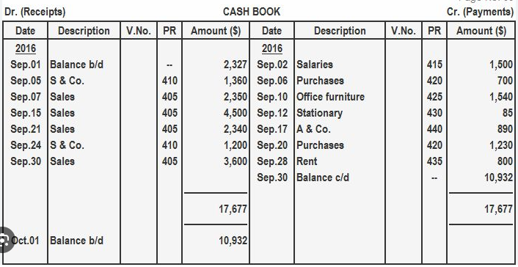
Cash Book: The Cash Book records all cash transactions, including cash receipts and cash payments. It serves both as a ledger and a journal, tracking cash inflows and outflows, including bank transactions.
It is divided into columns for cash, bank, and discount, providing a clear view of cash flow.

Slide 7
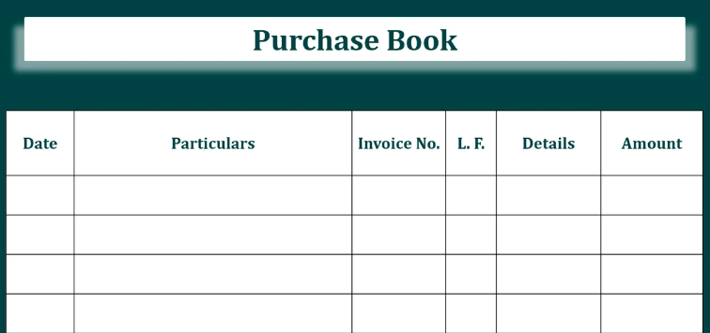
Purchase Book:
Purchase Book: The Purchase Book, also known as the Purchases Journal, is used to record all credit purchases of goods or services that the business intends to resell. It excludes cash purchases and non-merchandise purchases (like assets), and it is summarized periodically to post totals to the ledger accounts.

Slide 8
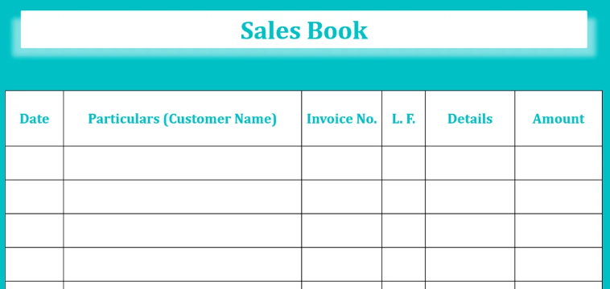
Sales Book:
Sales Book: The Sales Book, or Sales Journal, records all credit sales of goods or services. Like the Purchase Book, it excludes cash sales. Entries from the Sales Book are periodically posted to the Sales Ledger and then to the General Ledger.

Slide 9
Purchase Returns Book:
Purchase Returns Book: Also known as the Returns Outward Book, this journal records goods returned to suppliers. These returns are typically due to issues such as defects or incorrect orders. The totals from the Purchase Returns Book are posted to the Purchase Returns Ledger.

Slide 10
Sales Returns Book
Sales Returns Book: The Sales Returns Book, or Returns Inward Book, is used to record goods returned by customers. These returns might be due to defects, damages, or other reasons. The totals are transferred to the Sales Returns Ledger.

Slide 11
Journal Proper:
Journal Proper: The Journal Proper, also known as the General Journal, records transactions that do not fit into any of the other special journals. This includes adjusting entries, closing entries, error corrections, and any transactions that are infrequent or irregular in nature.

Slide 12
Cash book Types
Single Column Cash Book
Double Column Cash Book
Triple Column Cash Book
Petty Cash Book

Slide 13
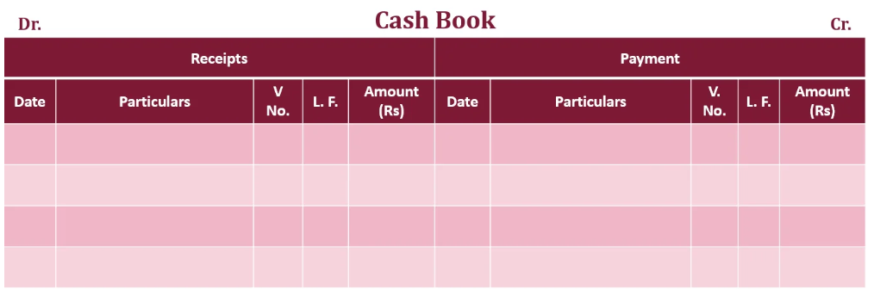
Single Column Cash Book
The simplest form of cash book is the Single Column Cash Book. It is like an ordinary Cash Account
The debit side of the cash book is used for recording all cash receipts and the credit side for all cash payments

Slide 14
Posting the Cash Book
i) for all transactions entered on the debit side of the cash book, credit the concerned accounts in the ledger by writing 'By Cash A/c' in the particulars column, and
ii) for all transactions entered on the credit side of the cash book, debit the concerned , I accounts in the ledger 'by writing 'To Cash A/c' in the particulars column.

Slide 15
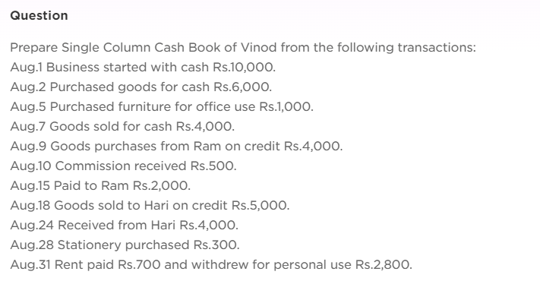
Exercise 1
Cash Book Balance Rs. 5,700

Slide 16
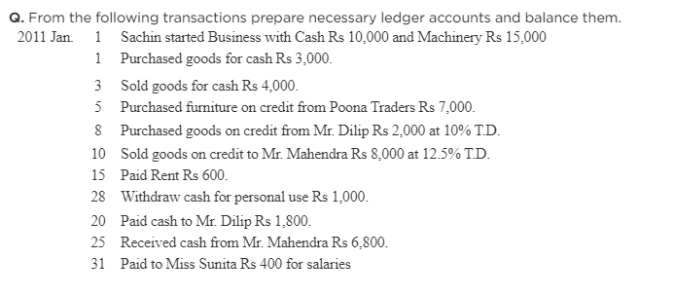
Cash book Balance Rs. 14,000

Slide 17
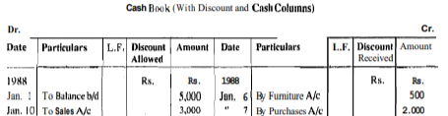
Two Column Cash Book
When cash is received from a debtor some cash discount may be allowed to him. Similarly, when payment is made to a creditor he may also allow some cash discount.
For this purpose, an additional amount column is provided on both sides of the Cash Book.

Slide 19
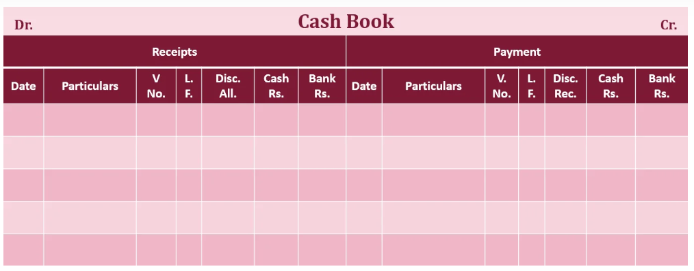
Three Column. Cash Book
The cash book containing a bank column, in addition to cash and discount columns, is called Three Column Cash Book. All receipts are recorded on the debit side of this cash book and all payments on the credit side.
When the amount is received or paid in cash, it is recorded in cash column and when it is done by cheque, it is recorded in the bank column. If discount is also involved, it will be shown in the appropriate discount column.

Slide 20
Contra Entry
There are some transactions which affect Cash Account and Bank Account in such a manner that one is to be debited while the other is to be credited
This happens only when either cash is deposited in the bank or cash is withdrawn from the bank.
The word 'contra' means 'the'other side' or 'the opposite side'

Slide 21
Contra Entry
One aspect is recorded on the debit side and the other on the credit side. For example, when cash is deposited in the bank it is recorded
(i) in bank column on the debit side of the cash book, and
(ii) in cash column on the credit side of the cash book.
Similarly, when cash is withdrawn from the bank it is recorded
(i) in cash column on the debit side of the cash book, and
(ii) in bank column on the credit side of the cash book. Thus, the double entry of the transaction is complete in the cash book itself. Such an accounting entry is known as 'Contra Entry'.

Slide 22
Petty Cash Book
A Petty Cash Book is a subsidiary cash book used to record small cash expenditures that are not significant enough to be recorded individually in the main cash book.
These expenditures typically include minor business expenses such as stationery, postage, transportation, and other miscellaneous items.

Slide 23
Key Points about the Petty Cash Book:
Purpose: The primary purpose of the petty cash book is to reduce the burden on the main cashier and prevent the main cash book from becoming too bulky with numerous small entries. It ensures that minor cash payments are tracked and managed effectively without cluttering the primary cash records.
Petty Cashier: A petty cashier is designated to handle the petty cash book. This person is given a fixed amount of money, known as petty cash, in advance to cover small day-to-day expenses.

Slide 24
Imprest System: It refers to a method of controlling cash expenditures, particularly small and recurring expenses.
Under this system, a fixed amount of cash, known as the imprest amount, is given to a petty cashier at the beginning of a period (e.g., a week or a month). This amount is used by the petty cashier to cover minor business expenses, such as stationery, postage, and transportation.

Slide 25
Recording and Posting the Petty Cash Book
The extreme left-hand column records the receipts of cash. But on the payment side a separate column is provided for each expense, such as postage, telegrams, stationery, cartage, wages, conveyance, etc.
The number of columns depend upon the nature and size of the business. The columns provided for different expenses generally are : (i) printing and stationery, (ii) postage and telegrams, (iii) cartage, (iv) conveyance, (v) entertainment. and (vi) sundry expenses.

Slide 26
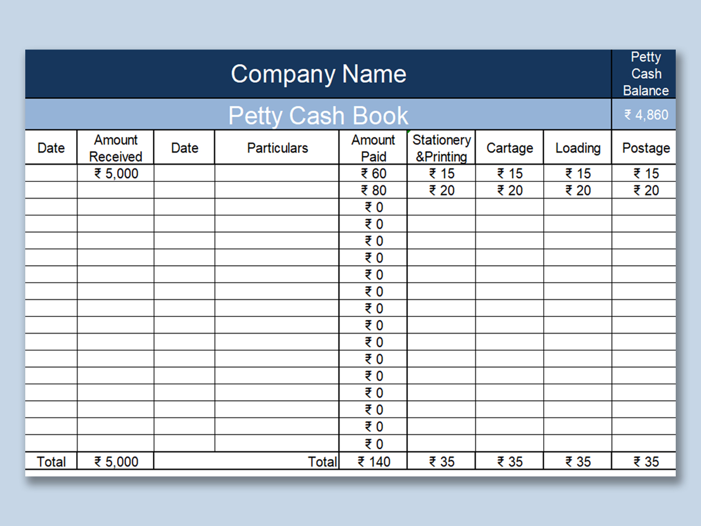
Petty Cash Format

Slide 27
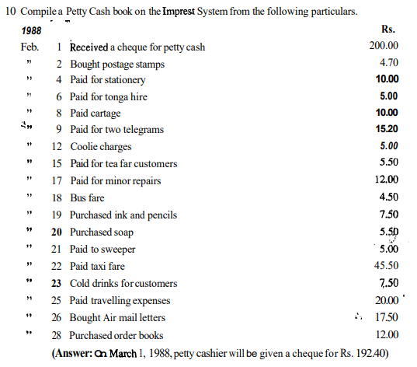

Slide 28
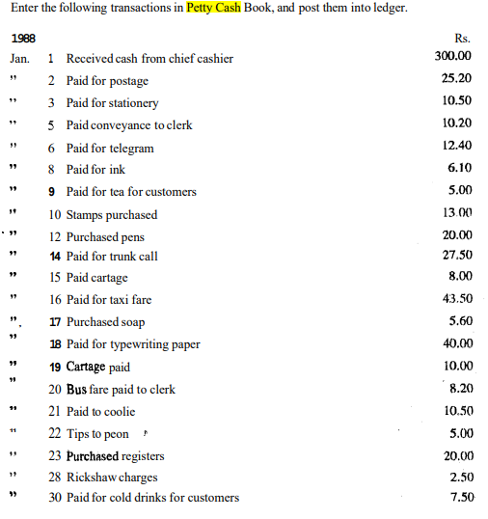
Ans : Petty Cash Book Balance: Rs.9.30

Slide 29
Note on Bank Reconciliation Statement (BRS)
Bank Reconciliation Statement (BRS) is a document prepared periodically by businesses to reconcile the differences between the balance shown in the firm's Cash Book and the balance shown in the Bank Pass Book (also known as the bank statement).
Purpose:
The primary purpose of preparing a BRS is to identify and explain the reasons for the discrepancies between the two balances.

Slide 30
Reason for Differences
Cheques Issued but Not Yet Presented: Cheques issued by the firm may not have been presented to the bank for payment by the end of the period.
Deposits in Transit: Amounts deposited by the firm into the bank may not have been credited to the bank account yet.
Bank Charges and Interest: The bank may have deducted charges or credited interest that the firm has not yet recorded in the Cash Book.
Errors: Errors may occur either in the Cash Book or in the Bank Pass Book, such as incorrect entries or omissions.

Slide 31
BRS Process
Comparison: The entries in the Cash Book and the Bank Pass Book are compared to identify any differences.
Adjustment: The identified differences are listed and explained. Based on these differences, necessary adjustments are made in the firm's accounts.
Reconciliation: A statement is prepared showing the balance as per the Cash Book, the balance as per the Pass Book, and the adjustments made to reconcile the two.

Slide 32
Importance of Importance:
Accuracy: BRS ensures that the firm's bank account balance is accurately reflected in its books, reducing the risk of errors.
Fraud Detection: Regular reconciliation helps detect unauthorized transactions or errors, thereby safeguarding the firm's assets.
Financial Control: BRS is a crucial tool for maintaining control over the firm's cash flow and ensuring that all transactions are properly accounted for.

Slide 33
Preparation-of Bank Reconciliation Statement
The Bank Reconciliation Statement is prepared at the end of a quarter, half year or a year as the firm may consider desirable and convenient.
It can be prepared in two ways :
i) Take the balance as per cash book as the starting point, adjust the effect of each item causing the difference, and arrive at the balance as per pass book.
ii) Take the balance as per pass book as the starting point, adjust the effect of each item causing the difference, and arrive at the balance as per cash book

Slide 34
Base for BRS Preparation
Whatever be the method, first of all you must analyse the effect of each item on the balance of the book which you are using as the starting point.
Generally, the firms adopt the first method because the Bank Reconciliation Statement is prepared primarily for the verification of the bank balance as shown by the cash book.

Slide 35
The items which can usually be adjusted in the cash book are :
1 Interest allowed by bank
2 Amounts collected by bank as per standing instructions
3 Payments made by bank as per standing instructions
4 Bank charges
5 Interest on overdraft
6 Direct deposits by customers
7 Dishonoured cheques or bills receivable
8 Errors committed in the cash book

Slide 36
list the items which would generally be added and subtracted when cash balance is used as the starting point.
To be added
1 Cheques issued but not yet presented
2 Interest allowed by the bank
3 Interest and dividends collected but not recorded in the cash book
4 Direct deposits by customers in the firm's bank account.
To be subtracted
1 Cheques deposited but not yet collected
2 Bank charges
3 Interest on overdraft
4 Amounts paid by the bank under standing instructions but not recorded in the cash book
5 Cheques dishonoured but no entry made in the cash book for the dishonour

Slide 37
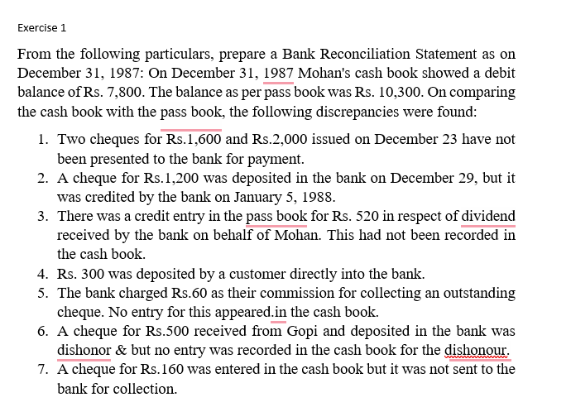

Slide 38
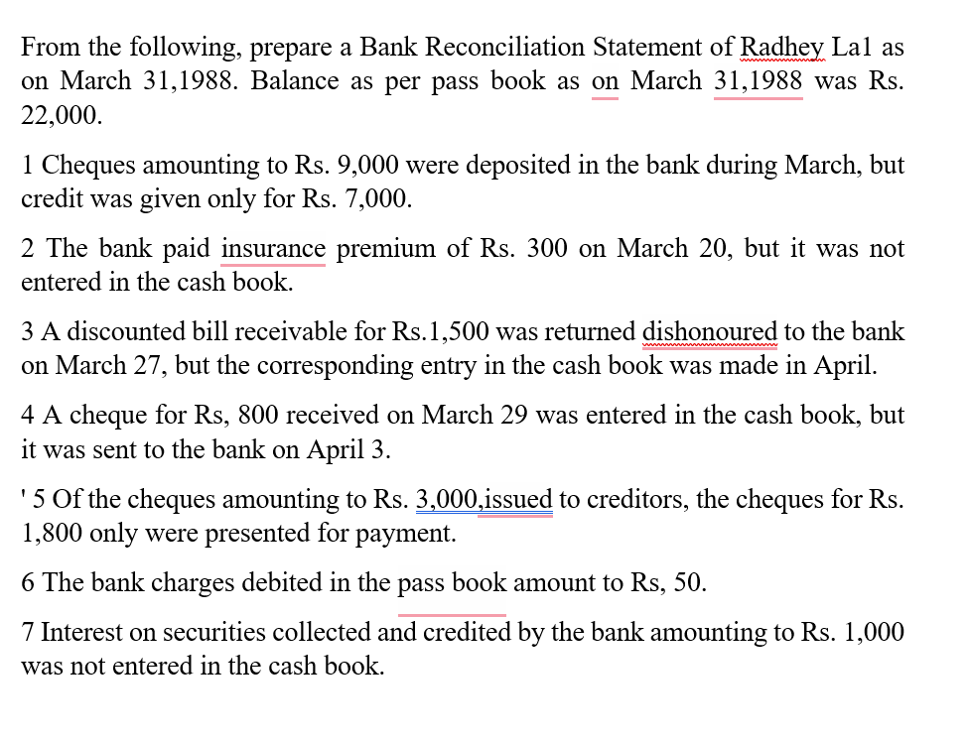
Ans : 24,420

Slide 39
Advantages of BRS

Slide 40
Format of BRS

